Slide 1
Iot-based Smart Cities: a Survey
TEAM MEMBERS:

Slide 2
INTRODUCTION ANDMOTIVATION
Due to the rapid growth of the population density in urban cities, infrastructure and services are required to provide the necessities of the city residents.
On this basis, there is a significant increase for digital devices, e.g. sensors, actuators, and smartphones that drive to huge business potentials for the IoT, since all devices can interconnect and communicate with each other on the Internet.
Smart cities have become smarter than before thanks to the recent developments of digital technologies.
A smart city is equipped with different electronic elements employed by several applications, like street cameras for observation systems, sensors for transportation systems, etc. In addition, this can spread the usage of individual mobile devices.
On this basis, the IoT will help to provide more efficient, economic and secure operation of the system based on different aspects, such as energy saving policies, economic considerations, reliability levels, etc.

Slide 3
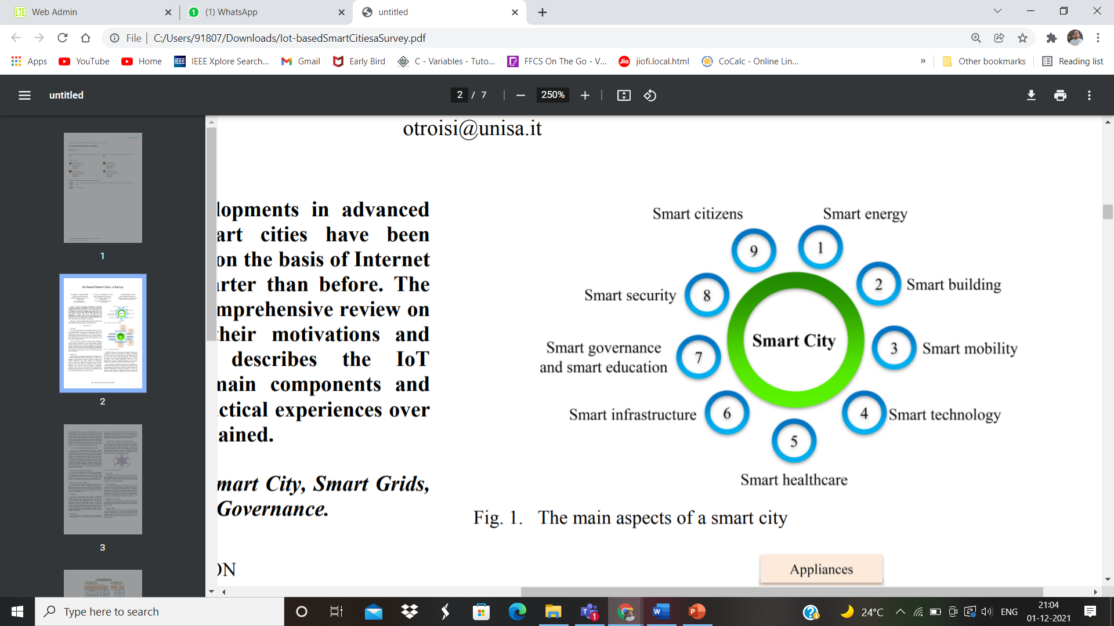

Slide 4
IOT TECHNOLOGIES FOR SMART CITIES
The main concept of the IoT is the universal presence of objects that can be measured, inferred, understood and that can change the environment.
On this basis, IoT is enabled by the developments of various objects as well as communication technologies.
Involved things in the IoT consist of smart devices including mobile phones and other objects like foodstuff, appliance, landmark, monument, work of art that can cooperate together to provide a common target.
A. Radio-Frequency Identification (RFID) :
These systems consisting of readers and tags are playing a key role in the context of the IoT.
By applying these technologies to any involved object, it is possible to carry out their automatic identification and assign a unique digital identity to each object, in order to be incorporated in the network and related to the digital information and service

Slide 5
B. Wireless sensor network (WSN):
WSNs can provide different suitable data and also may be used in many cases such as healthcare, government and environmental services and seismic sensing .
Furthermore, WSNs could be integrated with RFID systems to gain some goals like obtaining information regarding the position, movement, temperature, etc.
C. Addressing :
As well as the Internet can enable a remarkable interconnection of people, the existing trend in the IoT can similarly provide an interconnection of objects and things, in order to establish smart environments . To this end, the capability of uniquely identifying objects is crucial for favorable outcomes of the IoT.
D. Middleware:
As a result of some issues related to the heterogeneity of contributing things, to the restricted storage and process capability, the middleware plays a critical role in the interconnection of the objects to the application layer.
The key objective of the middleware is, indeed, to concisely integrate the functionalities and communication capabilities of all involved devices.

Slide 6
IOT ACTUAL APPLICATIONS FOR SMART CITIES
The IoT utilizes the Internet to incorporate heterogeneous devices with each other. In this regard and in order to facilitate the accessibility, all available devices should be connected to the Internet.
A. Smart homes :
Smart homes could be monitored by using the data that are generated by the sensors .
For instance, innovative demand response (DR) functions can be implemented or by monitoring the pollution, it will be possible to alert customers if the pollution exceeds its marginal limit.
B. Smart parking :
lots By enabling smart parking, arrival and departure of various vehicles can be tracked for different parking lots distributed in the city.
Consequently, the smart parking lots should be designed in a way to consider the number of cars in each zone .Moreover, new parking lots should be established where a higher number of vehicles are available.

Slide 7
C. Weather and water systems :
Weather and water systems can utilize some sensors to provide suitable information like temperature, rain, wind speed, and pressure and can contribute to enhance the efficiency of the smart cities .
D. Vehicular traffic:
Vehicular traffic data are one of the most important data sources in a typical smart city in which, by using these data and applying a suitable analysis, citizens and the government will benefit greatly . Citizens could be also able to use the vehicular traffic data to determine the arrival time to a destination .
E. Environmental pollution:
A city cannot be considered as a smart one if its citizens are unhealthy. To this end, a smart city should monitor the environmental pollution and deliver the related information to citizens, especially to those with health care conditions. Reference,also reported a separate module to achieve noise and environmental data.

Slide 8
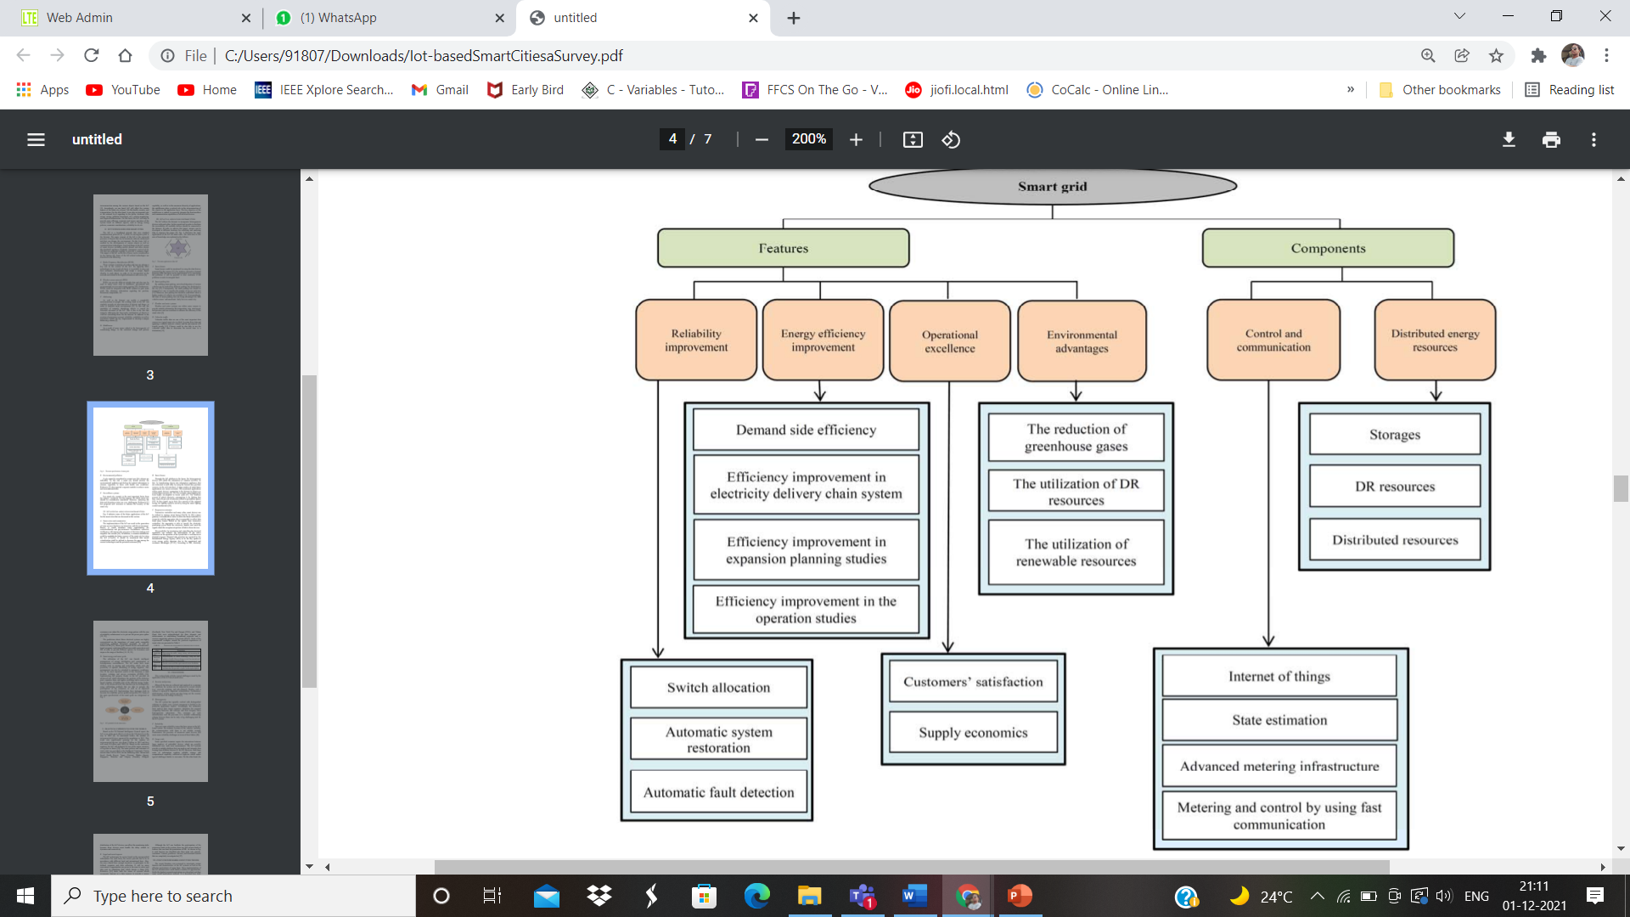

Slide 9
IOT POTENTIAL APPLICATIONS FOR SMART CITIES
A. Smart cities and communities:
The implementation of the IoT can result in the generation of some services that have an interaction with the environment.
Hence, it could introduce some opportunities for contextualization and geo-awareness.In addition, a common middleware could be available for future services of the smart city by using the IoT.
B. Smart homes :
Through the IoT platform in the home, the heterogeneous devices will enable the automation of common activities. In fact, by transforming objects into information appliances that are connected to each other by using the Internet may perform services via the web interfaces. A large number of smart-home applications use sensor networks.

Slide 10
C. Responsive customers:
Transactive controllers and many other smart devices can be utilized to manage smart homes .
In a home gateway is introduced in order to allow the home controller to cooperate with the aggregator who is responsible to collect data from many homes.
Based on the signals from transactive controllers, the aggregator is able to specify the electricity purchasing prices from the electricity market and send the signals about the acceptance/rejection of bids to these devices.
D. Smart energy and smart grids:
The utilization of the IoT can furnish intelligent management of energy distribution and consumption in heterogeneous circumstances.
The IoT nodes have some abilities such as sensing and networking which raise the possibility of optimal scheduling of energy suppliers.
This management can also be extended to emergency conditions.

Slide 11
PRACTICAL EXPERIENCES OVER THE WORLD

